Slide 1



overall_1_132573879104528179 columns_1_132573879104528179
Microsoft Office Add-ins
Community call
Marketplace leads for Office plugins are now becoming available in the Referrals Workspace
Add-in Auto Open for Word and Excel
Top 5 AppSource Validation Errors
December 14, 2022

Slide 2


Agenda
Sudha Padmanabhan
Yun Wang
Elizabeth Samuel
Senior Product Manager
Principal Product Manager
Senior Technical Writer

Slide 3

Marketplace leads for Office plugin offers are becoming available in the Referrals Workspace
Sudha Padmanabhan: Senior Product Manager

Slide 4
Quick poll
How many of you are part of the Commercial marketplace and/or Microsoft Cloud Partner (MCPP) program?
Notes:
A quick poll -

Slide 5
Office plugin leads
Leads are generated when a user tries your offer from AppSource and include their contact information.
In June 2022, we started delivering office plugin leads into Partner center.
Earlier you needed a CRM to get customer leads, but this was cumbersome for many partners.
We've made that optional now.

Slide 6
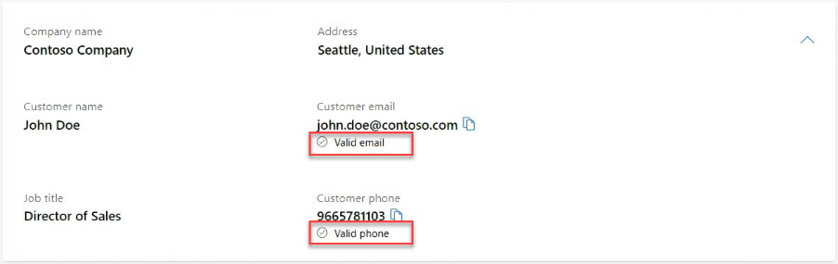
Partner center is your CRM
Our vision is to help Partner center be your CRM (especially if you are an app developer or a small ISV) – it is your one stop shop for Leads.
We're investing in Lead enrichment for your success
Contact enrichment – email and phone number validity was launched in August 2022

Slide 7
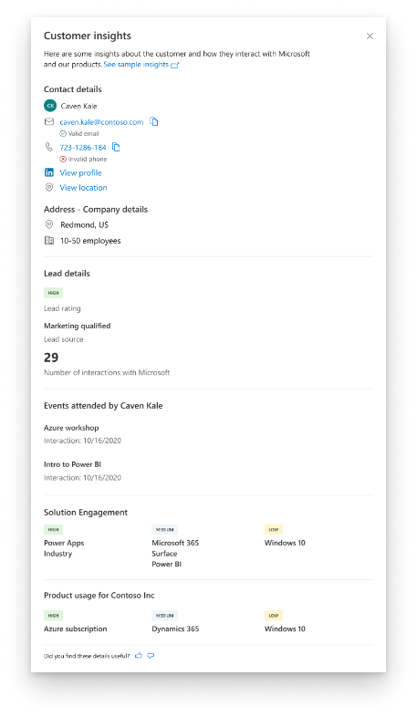
Lead enrichment
Upcoming feature – Launch in Jan 2023
Shows Lead rating, Interactions with Microsoft, Events attended and Product usage
Helps you understand your customers better
Lead rating helps you prioritize your leads as well.

Slide 8
Consent form
We are doing a backend linking process to deliver leads into Partner center
Fill out this consent form and check out these features soon!
https://aka.ms/OfficeLeadsConsent

Slide 9
Add-in Auto Open for Word and Excel
Yun Wang: Principal Product Manager

Slide 10
Different understanding of auto open (auto launch)
Add-in can be automatically installed and opened for a specific document.
Add-in can be automatically installed and opened for any document
Add-in can be automatically opened for a specific document only when it has been installed
Add-in can be automatically opened for any document only when it has been installed

Slide 11
Existing options to open an add-in automatically
Automatically open a task pane when an add-in is installed
Automatically open a task pane when an add-in is installed - Office Add-ins | Microsoft Learn
Embed an addin into a document
Open Excel from your web page and embed your Office Add-in - Office Add-ins | Microsoft Learn
The add-in is persisted in a specific document
Documents are generated from a system so that the system will embed add-in into document
Autoopen feature for specific document
Explicitly define or allow the user to define whether a specific task pane add-in persists in a specific document
Include an option in your UI for users to choose to no longer automatically open the add-in task pane.
Use requirement set detection to determine whether the autoopen feature is available, and provide a fallback behavior if it isn’t.
Automatically open a task pane with a document - Office Add-ins | Microsoft Learn

Slide 12
Further auto open requirements
Document automation, including setting labels, encrypting content, classification checking, data integrity checking, etc. All the documents in a company should go through such document automation process.
Add-in should be automatically launched when user receive a file/document shared by others, and need this add-in to keep doing work with that document. The add-in should be automatically installed for the shared document if it hasn’t been.
Add-in should be automatically launched if the user opened it last time and didn't close it. In this case, auto open happens for all the documents.
Add-in should be automatically launched for all the documents stored in specific locations.
Add-in should be automatically launched when specific events have been triggered. E.g. Save the document.
Let the admin decide which add-in should be automatically launched all the time.
Need your input – Collecting auto open requirements:
https://aka.ms/addin-auto-open

Slide 13
Further auto install requirements
I have both COM and JS add-in. If a user already has COM add-in on one device, I expect my Office on other devices without COM add-in to be automatically installed with JS-addin.
I want my JS add-in to be bundled with my main application. The installation can have both main application and add-in installed at the same time per user preference.
Add-in should be installed and launched automatically for our company's standard templates.
I need my JS add-in to be auto installed when I open a file shared by others, and I need the add-in to continue working with this file.
Need your input – Collecting auto open requirements:
https://aka.ms/addin-auto-open

Slide 14
Top 5 AppSource validation errors hit by Office Add-ins' submissions
Elizabeth Samuel: Senior Technical Writer

Slide 15
Top 5 errors
Additional charges not disclosed
First-run experience unclear
No links for sign in, sign out, sign up
ProviderName doesn’t match Publisher name
Testing instructions missing or inadequate
Based on data as of November 2022

Slide 16
Additional charges not disclosed
Does your add-in have any dependencies on additional accounts and services? Do they require purchase?
Ensure this information is included in the description of your add-in’s AppSource listing.
For example: Account/Service name, site link so user can acquire it
Related policy: 1100.1 Microsoft 365 > General content

Slide 17
First-run experience unclear
Does your add-in have a clear value proposition? Describe functionality and benefit in at least 1-2 lines on the add-in’s start screen
Is the add-in’s first-run experience seamless?
If users must sign in or sign up to use the add-in, is the value of the associated account/service clear to them in the add-in UI before they sign up?
Add-in targets Enterprise? If so, you can instead include an email contact or link in the add-in UI for users to learn about your services
Related policies:
1100.1 Microsoft 365 > General content
1100.5 Microsoft 365 > Customer control

Slide 18
No links for sign in, sign out, sign up
Does your add-in depend on external accounts or services?
If so, your add-in must provide clear and simple experiences for sign in, sign out, and sign up
Add-in targets Enterprise? If so, you don’t have to provide a sign-in experience if sign-ups are managed by the enterprise outside of the add-in and not by the individual user
Related policy: 1100.5 Microsoft 365 > Customer control

Slide 19
ProviderName doesn’t match Publisher name
What is the name in the ProviderName element of the add-in manifest?
Is it identical or similar to the name associated with your Publisher ID?
Related policy: 1120.3 Office Add-ins: Word, Excel, PowerPoint, and Outlook > Functionality

Slide 20
Testing instructions missing or inadequate
Did you provide enough test instructions so that the certification reviewer can successfully validate your add-in?
If your add-in has account/service dependencies (direct and external), have you included test credentials, product keys, etc.?
Does your add-in contain custom functions? If so, did you include test instructions for at least one of your custom functions?
Especially for complex scenarios: Clearly describe your add-in’s scenarios, upload screenshots, etc.
Related policy: 100.14 General > Testability

Slide 21
Resources
Key marketplace certification policies related to Office Add-ins
100 General
1100 Microsoft 365
1120 Office Add-ins
Marketplace certification policies
Office store apps checklist: Am I ready to publish?
Office store apps: Store step-by-step submission guide
Related blog post: Top 5 AppSource validation errors for Office Add-ins submissions

Slide 22
Question:
When using SSO, the samples use a .ENV file to contain the secret.
Are there any links on where to put the secret when you release to production?
Answer:
We recommend you use something like Azure Key Vault for securely storing and accessing secrets on your production app service.
Azure Key Vault Overview - Azure Key Vault | Microsoft Learn
Q&A

Slide 23
Question:
We are Scribe an email signature management software. We developed an Outlook Addin with an event base integration to insert the signature on the "OnNewMessageCompose" event.
But, we have users that have aliases and when they change the "From" address we would like to be able to re-trigger the Addin script to insert the alias signature. Is there a way to do that?
If not, is there a possibility to implement a new event for that in the future?
Answer:
This feature is actually going to be delivered in the near future, stay tuned for an update on the release date.
Q&A

Slide 24
Question:
Could you explain the difference between '@azure/msal-node' and '@azure/msal-browser’?
Answer:
@azure/msal-node is for node JS support, and @azure/msal-browser is for clients running in the browser like SPA. Here are a few documentation pages that may come in handy:
The following outlines the complete list of platforms supported by msal: AzureAD/microsoft-authentication-library-for-js: Microsoft Authentication Library (MSAL) for JS (github.com)
This github link provides more in-depth information for msal-node:
microsoft-authentication-library-for-js/README.md at dev · AzureAD/microsoft-authentication-library-for-js (github.com)
Q&A

Slide 25
Question:
How do we correctly specify API requirement sets per host for a multi-host Add-in?
Background:
Our Add-In (https://appsource.microsoft.com/en-us/product/office/WA200004485?tab=Overview) supports both Word and PowerPoint. It can't be installed/doesn't appear for Powerpoint on the Web, but works fine for PowerPoint Desktop and all Word versions. We're not sure if our manifest specifies some incompatible APIs, or if there's some other issue.
We included the API requirements in the following places in the manifest:
Common requirements: OfficeApp->Requirements->Sets
Host-specific requirements: OfficeApp->VersionOverrides->Requirements->Sets
According to this article: https://github.com/keyur32/add-in-docs-new/blob/master/docs/overview/specify-office-hosts-and-api-requirements.md#options-to-specify-office-hosts-or-api-requirements, we should probably not specify the host-specific requirements at all and just do runtime checks. But then again, why does our plugin install in all versions except for PowerPoint on the web?
We couldn't get the compatibility checker to work because of 2FA requirements in our organisations. https://learn.microsoft.com/en-us/microsoft-365/admin/manage/centralized-deployment-of-add-ins?view=o365-worldwide#centralized-deployment-compatibility-checker
Answer:
It would be great if you could submit this as a question here: https://aka.ms/office-addins-dev-questions with all of the details you have provided above.
Q&A

Slide 26






New to Office Add-ins?
 | Documentation | https://aka.ms/office-add-ins-docs
 | Quick starts | Outlook, Excel, Word, PowerPoint
 | Script Lab | https://aka.ms/getscriptlab
 | Samples | https://aka.ms/officeaddinsamples
 | Microsoft 365 Developer Program | https://aka.ms/M365devprogram
 | Office Scripts | aka.ms/office-scripts-docs
Notes:
m365-dev-sig

Slide 27
Engage with the team
Engagement | Where to go
Technical questions about Office Add-ins | https://aka.ms/office-addins-dev-questions [office-js-dev] [office-addins-dev] https://stackoverflow.com [office-js] [outlook-web-addins] [office-scripts]
Product bugs | https://github.com/OfficeDev/office-js
Feature requests and ideas | https://aka.ms/m365dev-suggestions
Send a Smile or Frown | Inside Office
Notes:
m365-dev-sig

Slide 28
Microsoft 365 developer community calls
Microsoft 365 platform call (weekly) https://aka.ms/m365-dev-call
Microsoft 365 & Power Platform Development (bi-weekly) https://aka.ms/m365-dev-sig
Viva Connections &
SharePoint Framework (bi-weekly) https://aka.ms/spdev-spfx-call
Adaptive Cards (monthly) https://aka.ms/adaptivecardscommunitycall
Microsoft identity platform (monthly) https://aka.ms/IDDevCommunityCalendar
Office Add-ins (monthly) https://aka.ms/officeaddinscommunitycall
Power Platform (monthly) https://aka.ms/PowerPlatformMonthlyCall
All calls and assets: https://aka.ms/m365pnp
Notes:
m365-dev-sig

Slide 29
Thank you
Recording will be available in 24 hours on
Microsoft 365 Community (PnP) YouTube channel
https://aka.ms/M365PnP/videos
(subscribe today)
Follow us on Twitter
@Microsoft365Dev | @M365PnP
Next call: January 11th at 8:00 AM Pacific Time
https://aka.ms/officeaddinscommunitycall
Agenda: https://aka.ms/officeaddinsagenda
Submit your questions: https://aka.ms/officeaddinsform

